Slide 1

456 West Main Street
Norwich, CT 06360
800-888-5275
rotary@bokoffkaplan.com

Slide 2

ABOUT OUR AGENCY AND THE ROTARY DEPARTMENT
Over 65 years in the travel industry
Full-service agency offering leisure, corporate, group and meeting travel services
Over 30 years arranging Rotary Youth Exchange travel and documentation
Three full-time agents dedicated to Rotary Students and their parents
Notes:
Bokoff Kaplan Travel, located in Norwich, CT is a full service travel agency with over 65 years in the industry. We have also been arranging Rotary Youth Exchange travel and documentation for over 30 years. We have 3 full time agents dedicated to Rotary Students and their parents.

Slide 3
SERVICES PROVIDED TO ROTARY STUDENTS
Step-by-step, easy to follow instructions for completing visa or residency permit documents
Air tickets that meet Rotary requirements
Toll free number for students and parents to receive advice and ask questions
Extended hours of operation during the summer months
Notes:
Our department’s job is to make sure that you are traveling into your host country with the proper documentation and on the correct type of airline ticket. In order to do that, we provide each student with step-by-step, easy to follow instructions to make the process of filling out visa and residency permit documents as easy as possible for you.
We ONLY issue airline tickets that meet Rotary requirements. We also have a toll-free number for students and parents to receive advice and ask questions, and from June 15th until August 15th we offer extended hours of operation, which means that an agent will be available to take phone calls until 7pm Monday through Thursday and also on Saturdays from 9am until 1pm.
In this presentation we’re going to give you as much information as possible to prepare you and help you become the best travelers possible. Please jot down any questions that may come up while I’m talking and then if your specific question isn’t answered in the course of the presentation we will have a Q&A session when I’m done.

Slide 4

HOW TO REGISTER
Go to our website: www.bokoffkaplan.com
Click on the tab for “Youth Exchange”
Click on the link for “Registration”
Notes:
-Your first order of business is to register with us. You can do this by going to our website at www.bokoffkaplan.com and clicking on the tab for Youth Exchange and then the tab for registration.
-ONCE YOU’VE REGISTERED WITH US, WE WILL BUILD A FILE FOR YOU IN OUR OFFICE WHERE WE WILL KEEP ALL INFORMATION PERTAINENT TO YOUR EXCHANGE. THEN, THE NEXT STEP WILL BE GETTING YOU GOING ON THE DOCUMENTS YOU HAVE TO COMPLETE IN ORDER TO OBTAIN YOUR VISA.

Slide 5
REGISTRATION DEADLINES
BEFORE APRIL 1ST: $115.00
APRIL 2ND UNTIL JUNE 30TH: $170.00
AFTER JULY 1ST: $220.00

Slide 6

WHAT IS A VISA?
A visa is official permission from a foreign government to enter that country and stay for a specified period of time
Notes:
-As most of you will need a visa or residency permit in order to travel, we feel that one of the of the most important services we provide is assistance in obtaining a visa.
-A visa is official permission from a foreign government to enter that country and stay there for a specific amount of time. In most cases a visa is applied for through an Embassy or a Consulate, which are foreign government offices located in the U.S.
-When I refer to “documents” in this presentation, we are talking about documents that YOU will need to complete in order to obtain your visa for your specific host country.

Slide 7
Requirements vary country by country and consulate by consulate
Consulates have the ability to change visa requirements and fees at any time
Send us documents as you complete them
Notes:
-Document and other visa requirements will vary from country to country and consulate by consulate. If you are going to Argentina, for example, the paperwork you need to complete will be totally different than your friend going to France.
-We ask that you be patient and flexible, as consulates have the ability to change visa requirements & fees at any time.
-Send us docs as you complete them; this will allow us to look them over and return them to you if any corrections need to be made. When documents are received and reviewed by your agent at BKT, you will receive an email telling you what we are still missing, if anything, what documents are being returned to you for correction, if any, or simply telling you that your file is complete and we will be applying for the visa shortly.

Slide 8

PERSONAL APPEARANCES
May be requested at any time
Photocopies of all documents must be sent to Bokoff Kaplan Travel prior to visit
Under 18 must be accompanied by at least one parent
Notes:
-There are two main ways to obtain a visa. Some of you will send all your original documents to Bokoff Kaplan travel and we will work directly with the Consulate FOR YOU; this obviously is the easiest way for you!
-Some Consulates, however, require that the applicant appear before them in person. When you receive your requirement information for your visa, you will be told if a personal appearance is required. However, even if it is not immediately required, the Consulate can request one at any time during the process.
-If you need to make a personal appearance, photocopies of all documents must be sent to BKT. Once we have reviewed the documents and found them to be complete we will email the student with contact information for the Consulate. If an appointment can be made, the student should call to set that appointment.

Slide 9
RECEIVING DOCUMENTS ONLINE
Email with individual username and password will be sent after student registers online
CHECK YOUR ACCOUNT OFTEN FOR UPDATES
Notes:
So, how do you find out what documents you will need to complete and whether or not you need to make a personal appearance? After you complete the registration form, you will receive an email with your unique username and password. This account is where the documents you need to complete for your visa will be posted, so check your account often for updates.

Slide 10
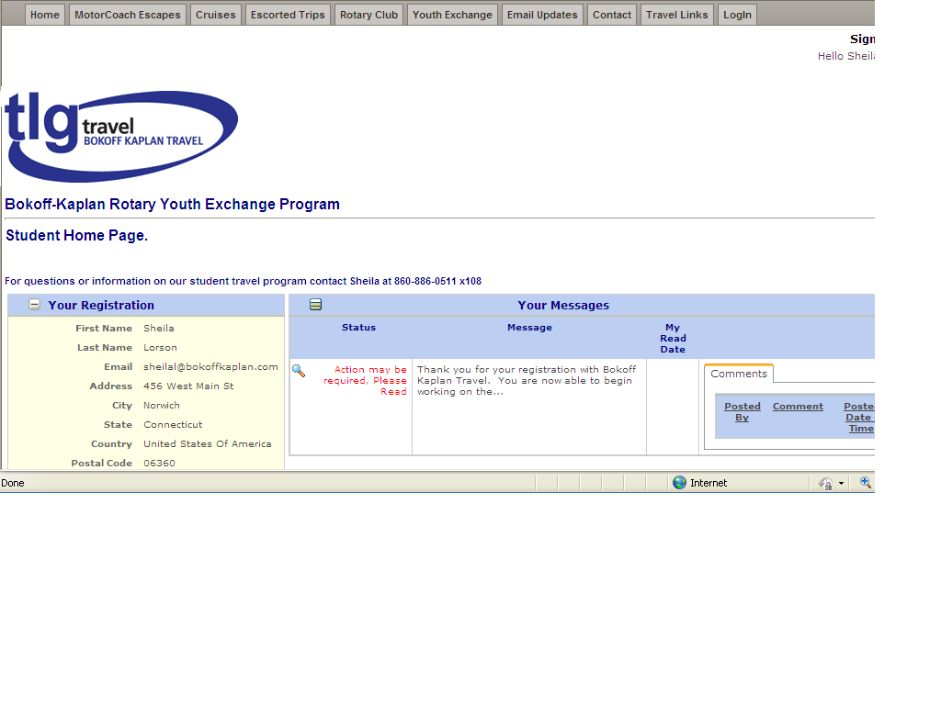
Notes:
This is an example of what your home page will look like. To read your message, click on the magnifying glass under the “Status” section of the page.

Slide 11
COMPLETING DOCUMENTS
Read through everything before beginning to fill out any papers
Use your full name as it appears on your passport
Pay close attention to samples
Notes:
-It is very important that you read through all your documents thoroughly before starting to complete anything.
-Use your full name as it appears on your passport
-You will be provided with samples of visa applications and occasionally some other documents as well. These will be completed as if we were the applicant, so remember to use them as a guideline only! We get a lot of applications back with our information on it.

Slide 12
DOCUMENTS
  Some documents will require notarization; if you do not know a notary public look for one in the yellow
  pages (www.yellowpages.com)
  If biological parents do not reside together, two separate forms may be completed and notarized separately
  Many (but not all) Consulates require submission of the applicants birth certificate WITH A RAISED SEAL. If you only have one original birth certificate it is a good idea to get another certified copy now (www.vitalchek.com)

Slide 13
Sign all documents in blue ink
Print out a copy of all documents you complete to keep at home
Use your document checklist
Do NOT send us visa fees or any other payments
Notes:
-Sign all documents in blue ink unless instructed otherwise. This will help the Consular officials know that the signatures on the forms are original.
-Parents are urged to take photocopies of all documents and keep them in a safe and secure location. Especially important are the student’s passport, RGF and visa once it is issued.
-Each of you will be provided with a document checklist. Use it! It will help you know what documents you still need to work on and which ones have been completed and received by BKT.

Slide 14

ADHERE TO DEADLINES!
Notes:
The visa process is very complicated and time sensitive. Every Consulate issues their visas in their own time, and your document deadlines have been set according to our past experiences with the specific office we will obtain your visa through.

Slide 15
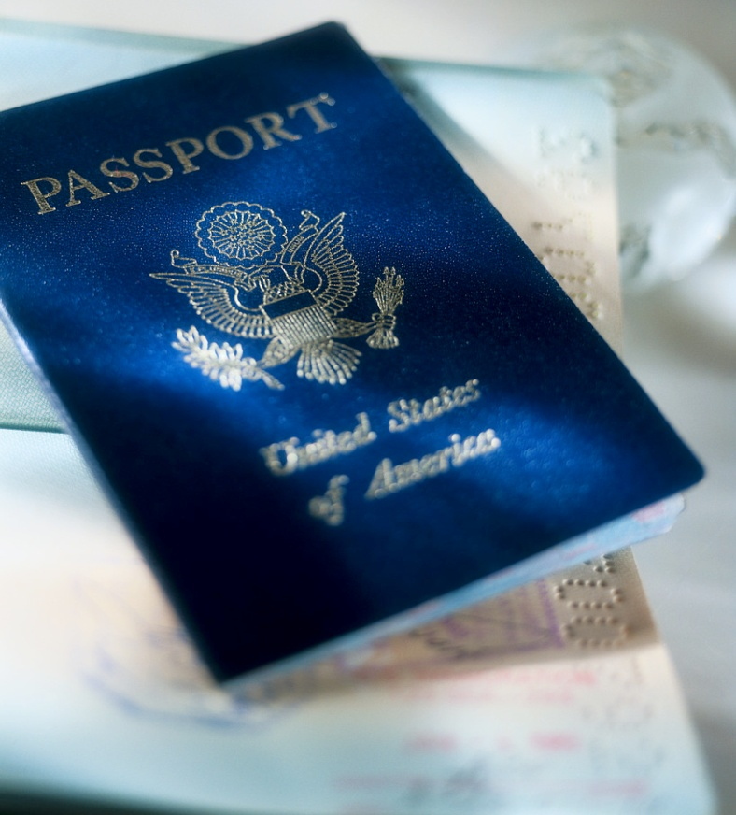
PASSPORT
ALL students will need a valid passport in order to travel
Must be valid for at least 6 months from your expected date of return
Sign full name in blue or black ink only
Notes:
-All students will need a valid passport in order to travel. If you have not applied for your passport yet, you must do so immediately.
-If you already have a passport, check it’s expiration date. Your passport must be valid for at least 6 months from the expected date of return. This means that for most you, your passport needs to be valid until FEBRUARY OF 2010.
-Sign your name in blue or black ink only!

Slide 16
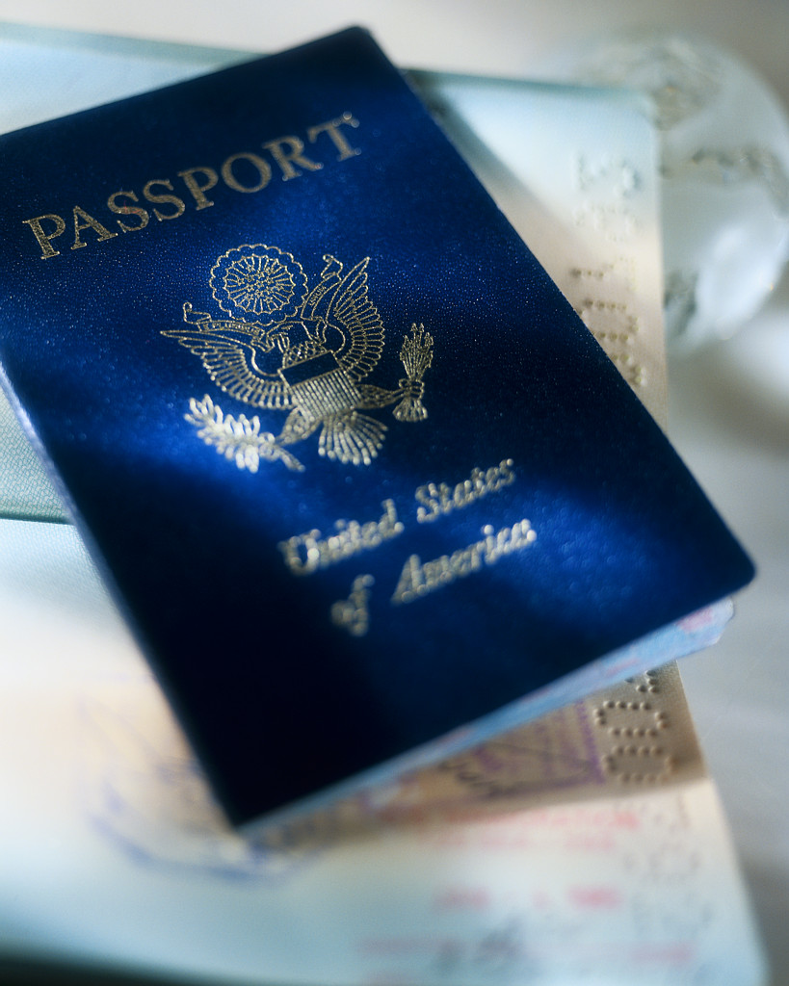
PASSPORTS
Parents should have a valid passport in case an emergency arises
Always send passports through traceable mail
Notes:
-Parents should each have a valid passport in case an emergency arises and there is a need for you to travel abroad.
-Fed ex, Airborne Ex, even Express USPS.

Slide 17
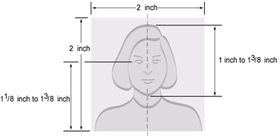
VISA APPLICATION PHOTOS

Slide 18
APPLICATION PHOTOS
(PASSPORT SIZE &QUALITY)
Do NOT submit your own digital photos
Do NOT submit class photos, family photos, snapshots or other “personal” photographs
Save yourself (and us) time and go to a local drugstore, WalMart, or other retail location that takes PROFESSIONAL PASSPORT PHOTOS

Slide 19
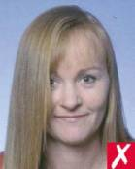

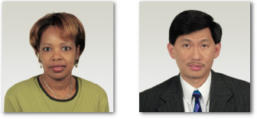

ACCEPTABLE PHOTOS
NON- ACCEPTABLE PHOTOS

Slide 20
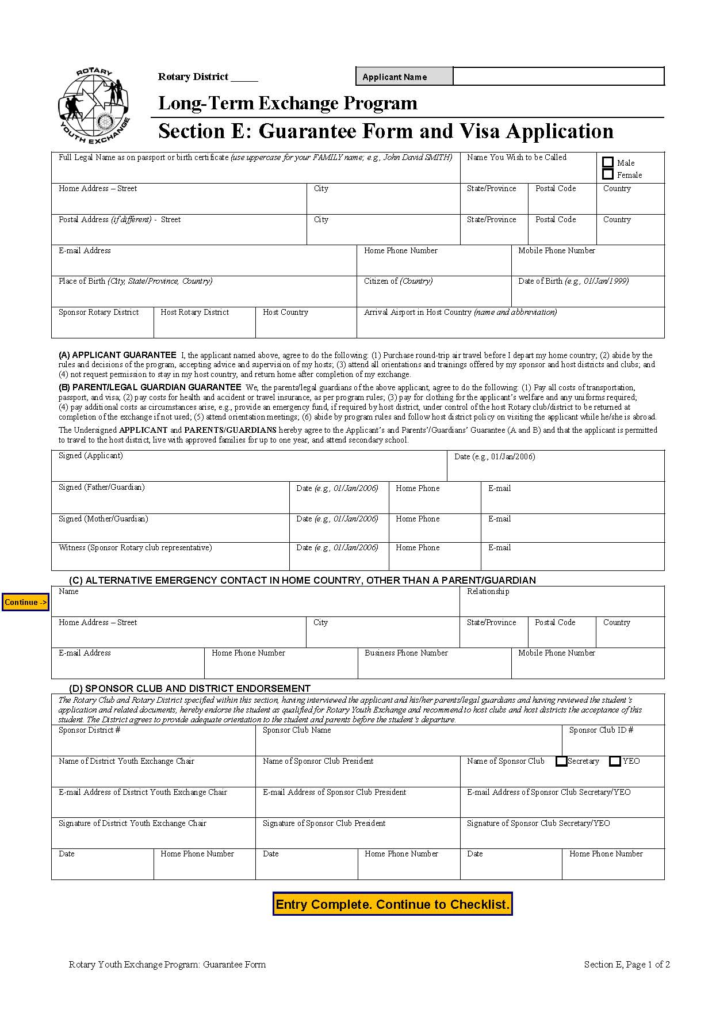
ROTARY GUARANTEE FORM
Your official acceptance from your host country
This is NOT your visa application form
Sent from the host country to Rotary in the US
Do NOT wait for this form to arrive before sending us your other documents
Notes:
-One of the most important documents for your exchange is a form called the Rotary Guarantee form. It is your official acceptance from your host country and you cannot obtain a visa or travel without it.
Please note that, although this form says “ROTARY GUARANTEE FORM / VISA APPLICATION” on the top, it is NOT a visa application form. If you need to complete an application form, it will be included in your online documents.
-This form is signed by you and your parents and then sent to your host country to be signed by your host district chair, host school official, first host family and host club counselor. Since it has so many desks to pass over, this form sometimes takes a long time to get back to us. Please be patient, and understand that we do not know the location of this form any more then you do, please do not call everyday to ask if we’ve received it. When Rotary in the US receives this form, they will more then likely send us the original and you a photocopy, unless we’ve instructed them otherwise.

Slide 21
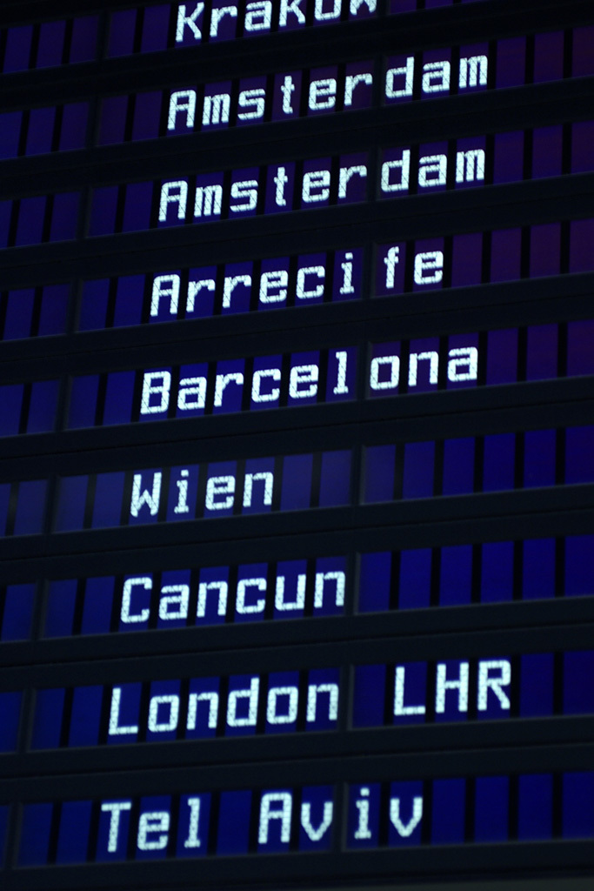
AIRLINE TICKETS
Round trip
Valid for one year
Returns can be:
  Open
  Issued with a return date changeable once at no fee
  Issued with a return date changeable for a nominal fee
Notes:
-All tickets issued by our office will meet Rotary requirements.
-The international portion at the very least will be round trip and all tickets will be valid for one year.
-The returns will be either:
-open
-issued with a date as far out in the system as possible with one free date change
-issued with a date and a date change at a nominal fee.
-Your return type will depend on the airline that you will be traveling on and you will be advised about the arrangements in advance.

Slide 22
AIRLINE TICKETS
Airfare quotes DO NOT include taxes, airline surcharges or airfares to your final destination in your host country
Frequent flyer and internet tickets typically do not meet Rotary requirements
Tickets valid for one year with an open return (Rotary’s requirement) are more expensive
Even if a ticket has an open return it is not free from restrictions

Slide 23
TRAVEL INFORMATION
Itinerary, invoice and fare rules will arrive via e-mail shortly after visa or other travel documents have been received or their arrival has been guaranteed
Read fare rules CAREFULLY and ask questions BEFORE signing and returning
Full payment must be received before tickets can be issued
Notes:
-Once the visa or other travel documents have been received or their arrival has been guaranteed to us, we will send you an itinerary and a list of fare rules that you will need to sign and return to us before tickets can be issued.
-ALL QUOTES WILL BE IN US DOLLARS
-The fare rules is a document that clearly outlines the rules behind your ticket and will require the signature of a parent and the student before any tickets are issued. Examples of some rules you may need to abide by are that the ticket is only valid for one year, you cannot change the origin or destination of your ticket or that you will receive one free date change on your return ticket, but will pay a fee for any subsequent changes.
-If you have any questions on the fare rules or the itinerary, call your agent at BKT BEFORE you sign and return them to us.

Slide 24
ITINERARIES
Expect longer layovers
Airlines determine the routing
If a group departure is available to host country, agent will always fit student’s schedule to meet other students

Slide 25
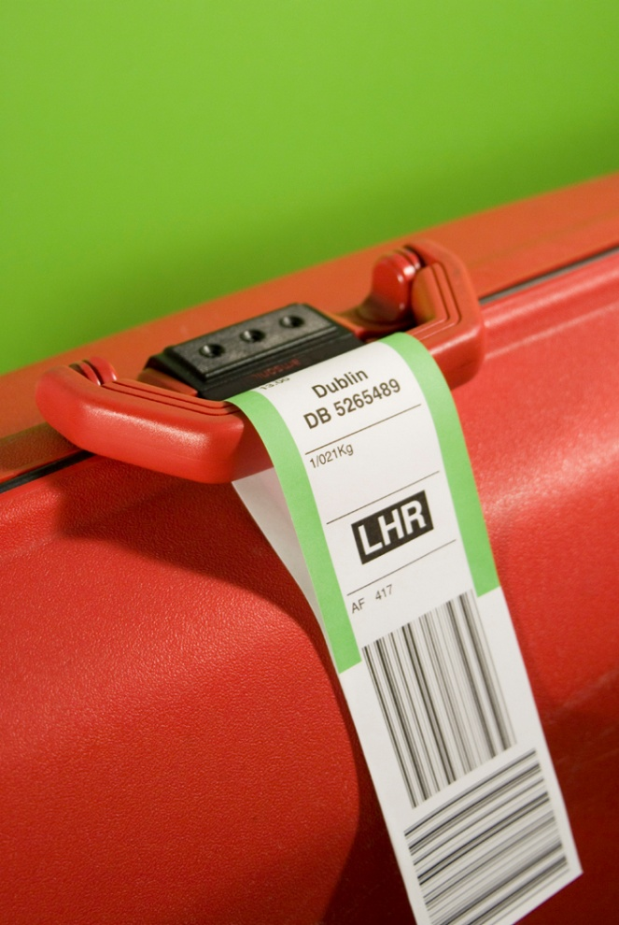
DEPARTURE PACKETS
Can arrive up to one day prior to departure depending on the timeliness of receipt of documents
Contents will include passport, baggage tags, itinerary, airport maps, packing and security information
Notes:
As previously mentioned, this can be a last minute process. There are occasions where we receive the visa at the last minute, and therefore we will be forced to get departure info to you at the last minute as well. Keep in mind that we have no control over how long the Consulates take to issue or return visas, but we do our best to get them back to you as soon as possible.
-The contents of the departure packet will include your passport, three baggage tags, two copies of your itinerary (one for the student to travel with and one for parents to keep at home), airport maps and packing and security information.

Slide 26
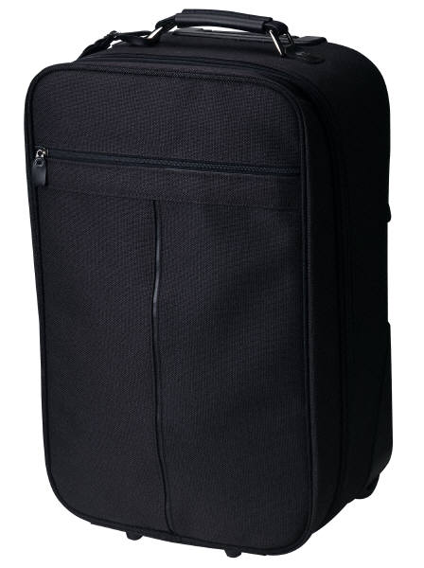
CHECK-IN BAGS
1 Bag at 50 pounds, 62 inches; 2nd bag at cost
Overweight bags and additional pieces of luggage will cost extra
Smaller US domestic and foreign planes and carriers may have different requirements
LENGTH
HEIGHT
WIDTH
Notes:
-Current typical weight allowances for check in bags is 1 bag per passenger that can be 50 pounds each.
-Exact charges will depend on what airline you are on and where you are traveling to
-Smaller US domestic and foreign planes and carriers may have different requirements. Once you know what airline or airlines you are traveling on, you should contact them and inquire as to their current requirements.

Slide 27
CHECK-IN BAGS
AIRLINES RESERVE THE RIGHT TO CHANGE BAGGAGE ALLOWANCES AND FEES AT ANY TIME!
LENGTH
HEIGHT
WIDTH
Notes:
AIRLINES CAN CHANGE THEIR BAGGAGE ALLOWANCES AND OVERWEIGHT AND ADDITIONAL PIECE CHARGE AT ANY TIME. THERE ARE NO WAIVERS OR SPECIAL CIRCUMSTANCES THAT WILL ALLOW YOU TO HAVE DIFFERENT LUGGAGE REQUIREMENTS THAN ANY OTHER PASSENGER.

Slide 28
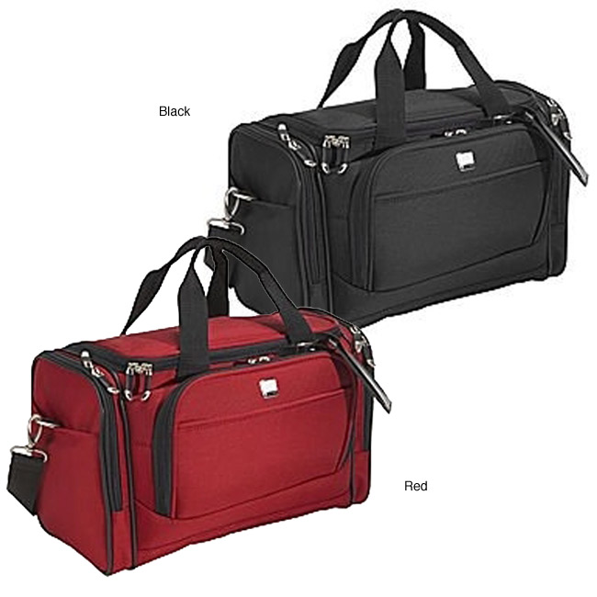
CARRY-ON BAGS
One per passenger plus one “personal item”
No more than 40 pounds or 45 inches
Notes:
Each passenger is allowed one carry on bag plus one personal item which can be a purse, camera bag, or a briefcase sized bag. Your carry on bag cannot be more then 40 pounds or 45 inches. You can get the dimensions of your carry on bag by adding the height, length or width of the bag.

Slide 29
HOW TO PACK
Make a list and stick to it
Leave valuable or sentimental items home
Pack comfortable, loose fitting clothes that match the weather and climate of your host city/country
DO NOT PACK TOO MUCH!!!!

Slide 30
IN YOUR CARRY-ON, YOU SHOULD HAVE….
Host family and chairman’s telephone number
Prescription medications
Toothbrush and a change of clothing
Notes:
-You may need quick and easy access to this information, so it is best to have it in your carry-on bag
-Any prescription meds should be accompanied by a note from your physician stating exactly how much you are carrying with you and its purpose.

Slide 31
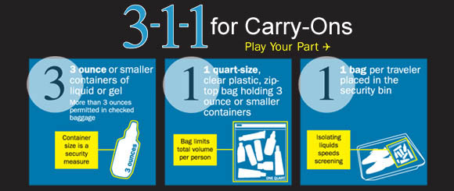

Slide 32
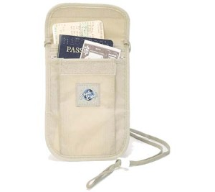
KEEP IMPORTANT ITEMS WITH YOU AT ALL TIMES!
PASSPORT
BOARDING PASSES
CASH
CREDIT / DEBIT CARDS
PHONE CARD
Notes:
We suggest you purchase a travel pouch like the one shown to keep your most important items close to you at all times. They are typically made of canvas with plastic lining, and in it you should carry your passport, your boarding passes, your cash, credit or debit cards and a phone card. Please note that you SHOULD NOT ever travel internationally without some cash. We suggest having approximately $200.00 in US cash and then some of your host countries currency with you as well to cover emergencies.
You should also purchase a phone card before you leave for your host country. Be sure you understand how to use the card before you go and make sure it can be used to call from the US to your host country and from your host country to the US.

Slide 33
CHECK-IN AT AIRPORT
Plan to check in 3 hours prior to flight
Be sure baggage tags are completed with HOST families address
Do NOT lock your suitcases for check in

Slide 34
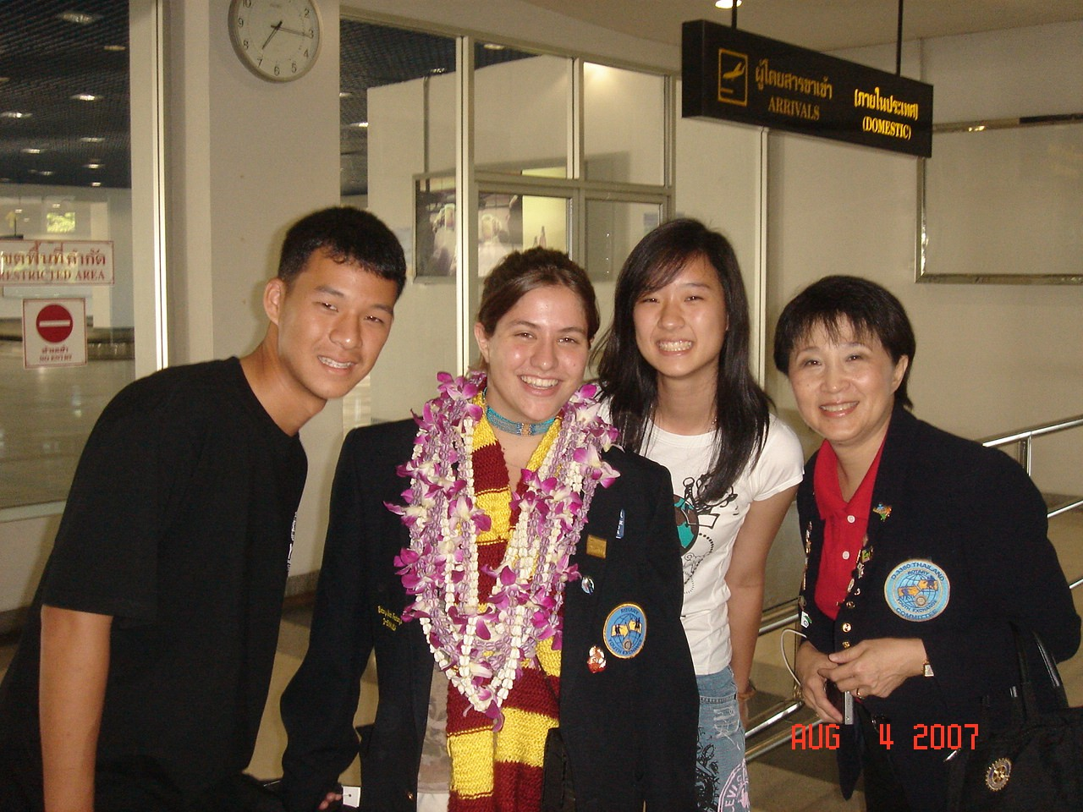
WEAR YOUR ROTARY BLAZER WHILE IN ANY AND ALL AIRPORTS
It will help other Rotary students and your host family recognize you
Customs and Immigration officials will know what you are doing in their country
Notes:
-This will help other Rotary students who may be traveling on the same day as you recognize you. This also helps customs officials know what you are doing in their country, as this is a world known symbol of Rotary International.
-When changing planes, check departure monitors for your next flight immediately after deplaning and go to your next gate right away. Once you have located your gate, do not wander far from that area for any reason. Be sure not to listen to headphones too loudly as you may miss important announcements.
-Keep your carry-on items with you at all times. Do NOT let them out of your sight!

Slide 35
SECURITY INFORMATION
All bags are subject to inspection
Do not carry sharp objects such as scissors, pocketknives, or metal fingernail files in your carry on bags
No inappropriate remarks regarding bombings, weapons or hijackings will be tolerated

Slide 36
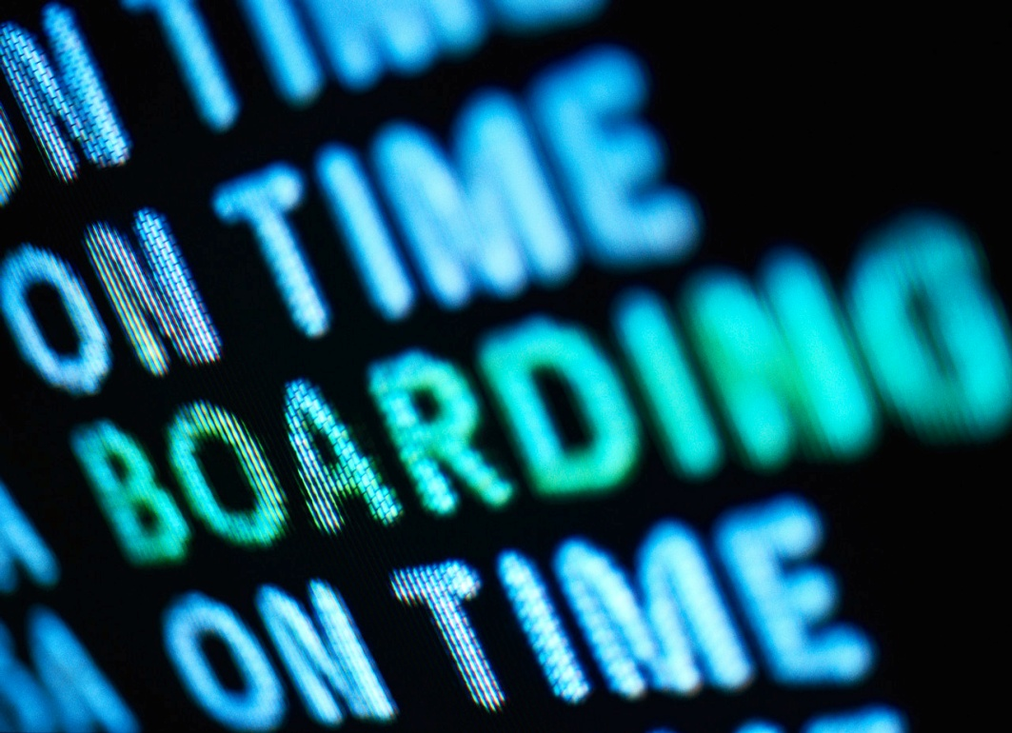
WHAT TO DO IF YOU MISS YOUR PLANE
Remain calm and polite
Ask to be booked on the next available flight
Contact parents

Slide 37
EMERGENCY CONTACT
Number will be given with departure packet
Agent will answer from home after business hours
Only use in case of TRUE emergency
Agent will NOT be able to contact hosts of new arrangements or delays

Slide 38
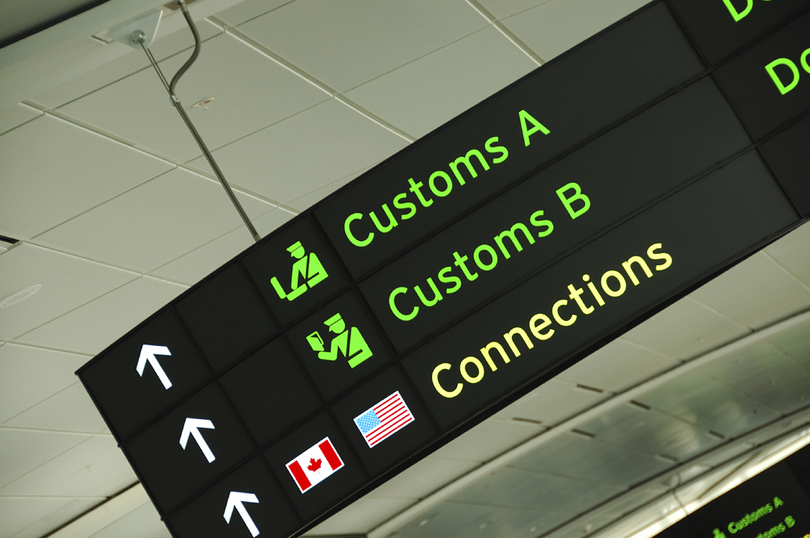
CUSTOMS & IMMIGRATION
Keep passport and tickets in hand
Be sure your immigration card is completed
Answer questions to the best of your ability
All baggage, personal effects and persons are subject to search

Slide 39
RETURN INFORMATION
Email sent to parents and students that contains:
  Return instructions
  Copy of Fare Rules

Slide 40
HOW TO DETERMINE A RETURN DATE
Discuss your options with:
  Your natural and host parents
  Your Rotary host club counselor and local Rotary Chair
  A host school official

Slide 41
CONTACT BOKOFF KAPLAN TRAVEL BY
FEBRUARY 15^{TH,} 2011
WITH A RANGE OF ACCEPTABLE RETURN DATES
Notes:
If you wait until after January 15th to contact us, or decide that you would like to change your date, you will need to get in touch with the airlines directly to book your return, and you will be subject to pay any fees they impose on you due to a lack of knowledge on our specially negotiated contracts. We will be unable to waive these fees for you, so it is in your best interest to be sure to contact us by this date.

Slide 42
1-800-888-5275
Sheila Lorson, Manager
sheilal@bokoffkaplan.com
Extension 108
Sabrina Burgett, Travel Consultant
sabrinab@bokoffkaplan.com
Extension 107
Theresa Bryan, Travel Consultant
theresab@bokoffkaplan.com
Extension 106

